Slide 1
3D Vision
(Foundations and two-view geometry)
NAAMII Winter School 2019, December 18th
Ajad Chhatkuli Computer Vision Lab @ ETH Zurich, NAAMII

Slide 2



Why in AI?
We move in order to see and see in order to move- William Gibson
We live in the real world
[source: Traveltourtrek Nepal]
Three pillars of AI - data, learning and knowledge
-Fei Fei Li
Bishesh Khanal and Ajad Chhatkuli. Second Nepal Winter School in AI. 2019

Slide 3
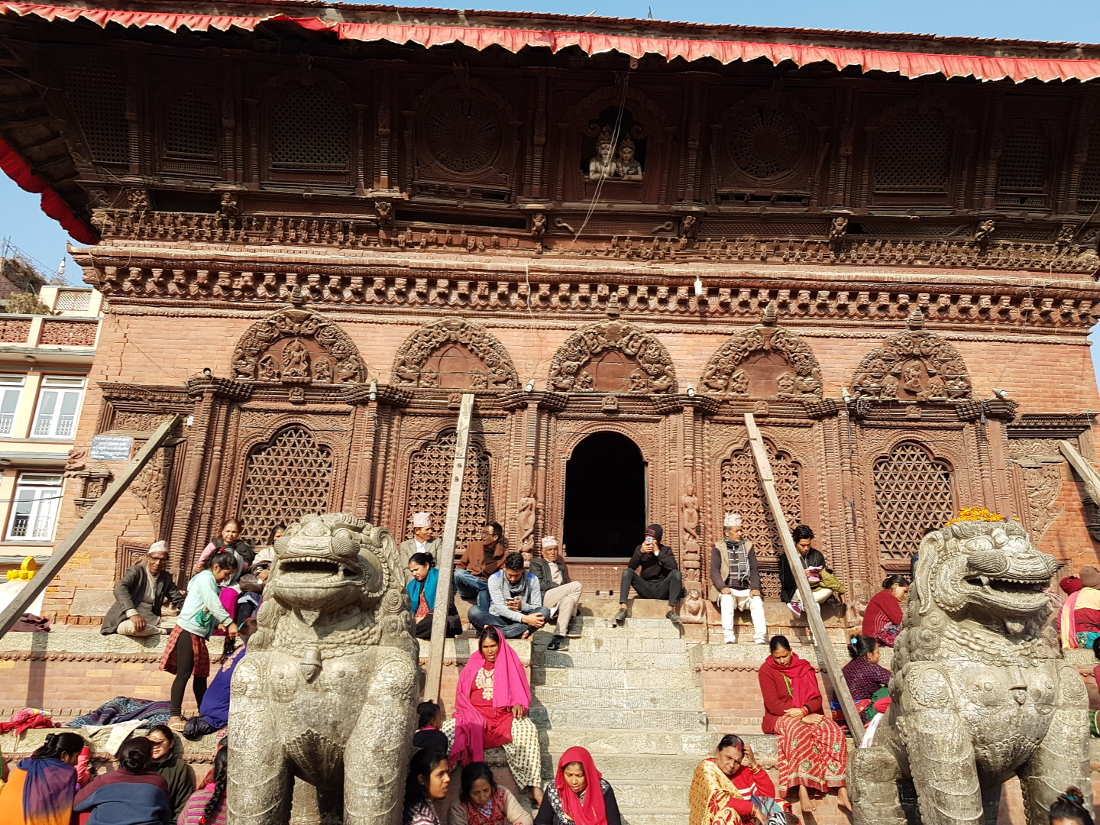
What will we learn here?
A 3D scene is projected on your camera.
What can you infer from the pictures
about the motion and the 3D scene?
Computer Vision/ AI

Slide 4
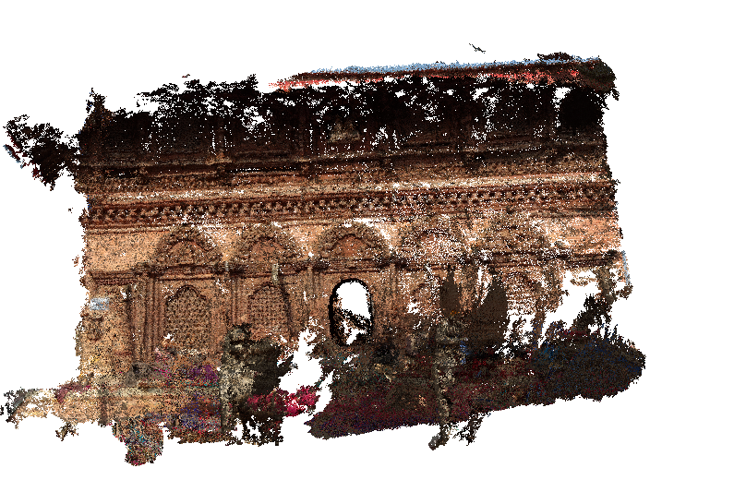
What tools will we use?
Linear Algebra
Optimization

Slide 5
Computer Graphics and 3D Vision
Given a 3D shapes and motion, construct realistic images
Given images, infer the motion and shapes

Slide 6

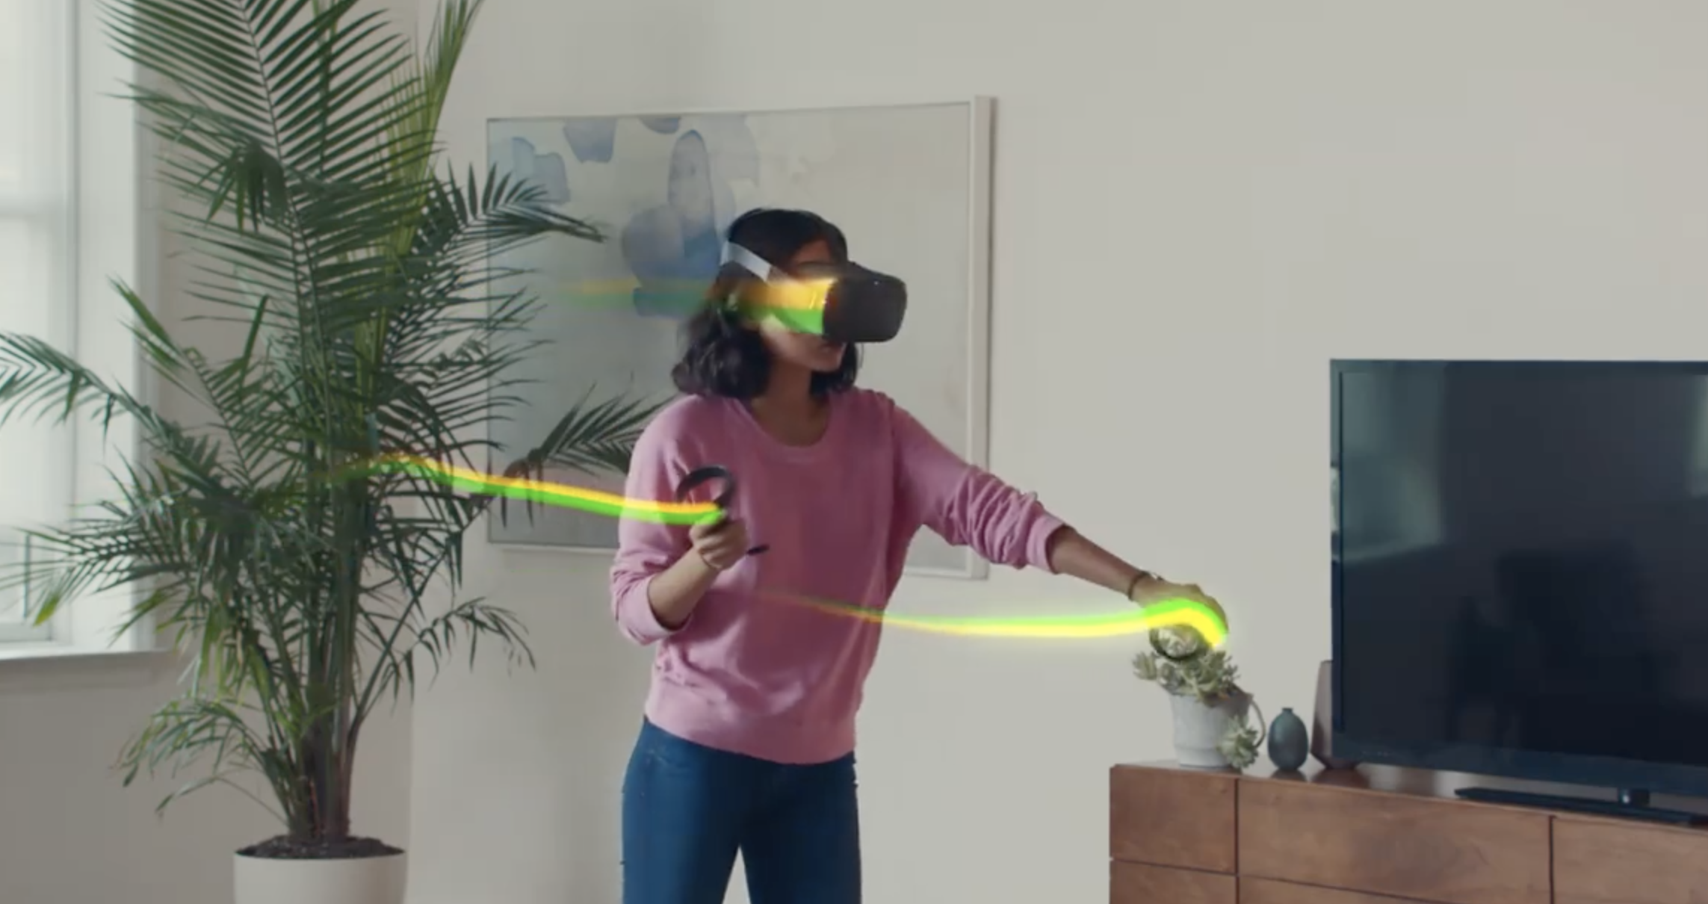
Augmented/Virtual Reality

Slide 7

Augmented Reality in Medicine
Source: Adrien Bartoli

Slide 8
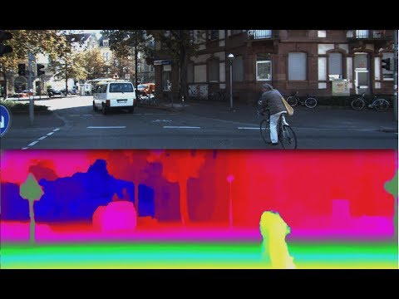

Slide 9
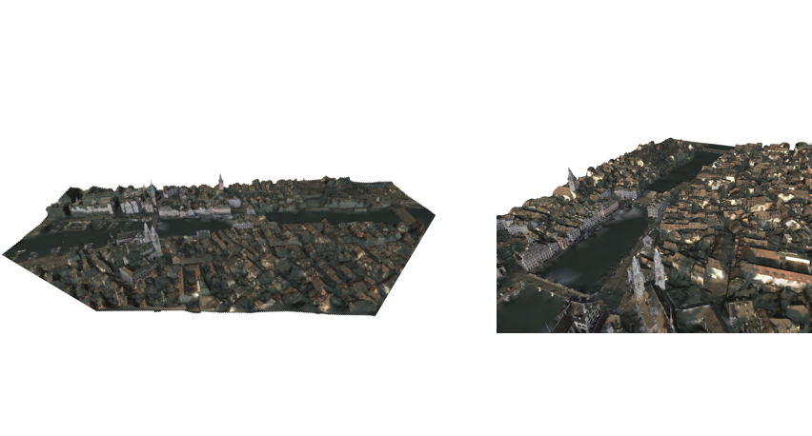
Mapping

Slide 10
Motivation
Augmented/Virtual Reality
Mapping
Robotics
Autonomous Driving
Unsupervised Learning

Slide 11
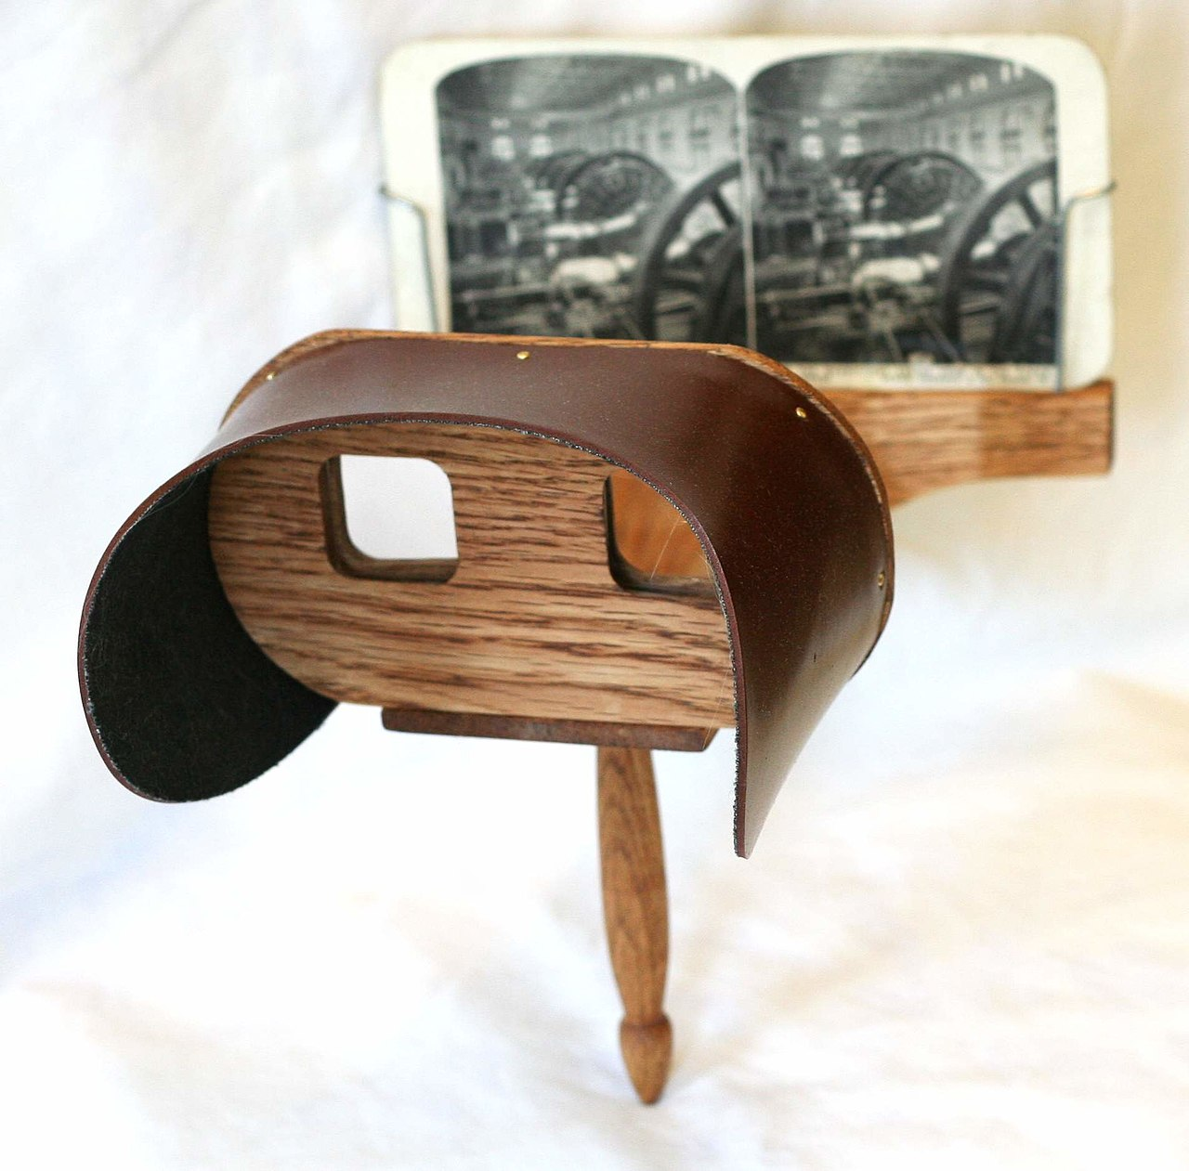
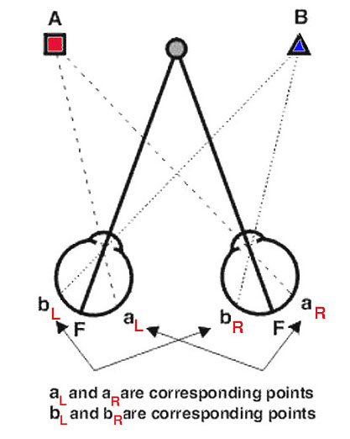
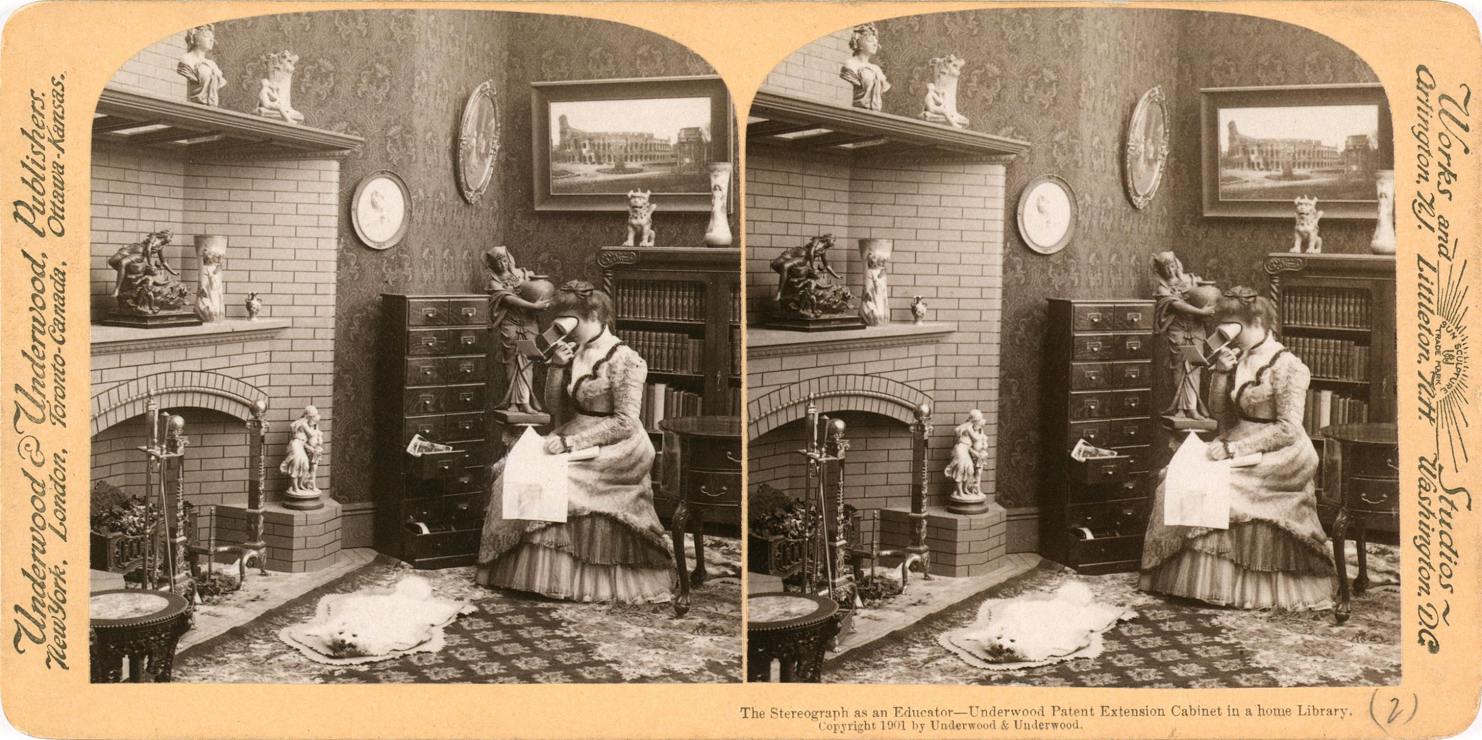
Introduction
How do we see 3D?
Disparity from stereo

Slide 12
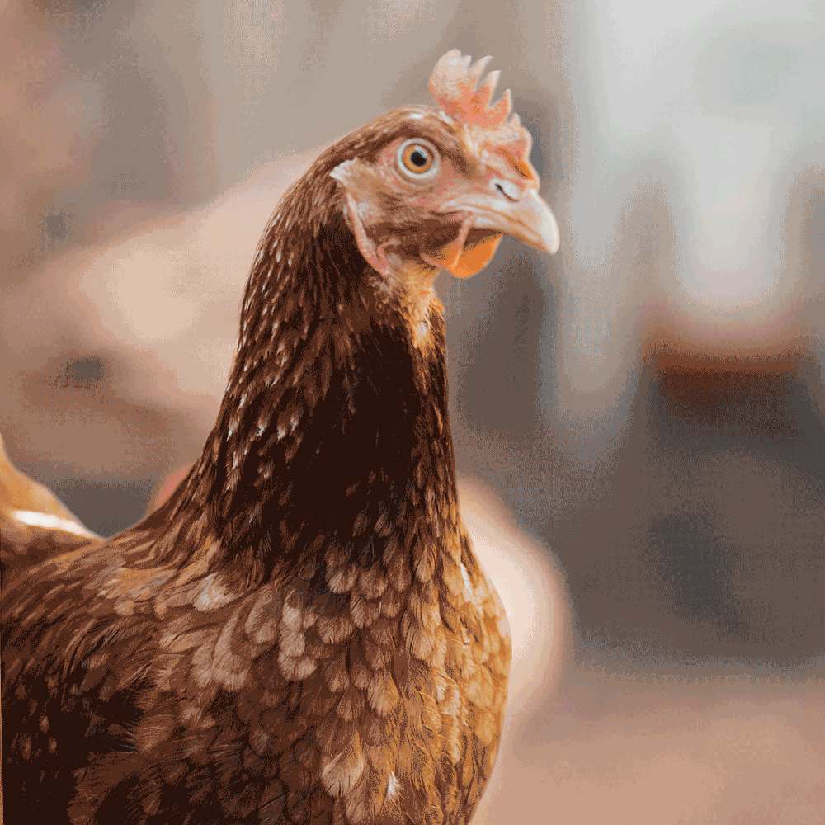
Introduction
Why does the chicken move its head
all the time?
Disparity under motion

Slide 13
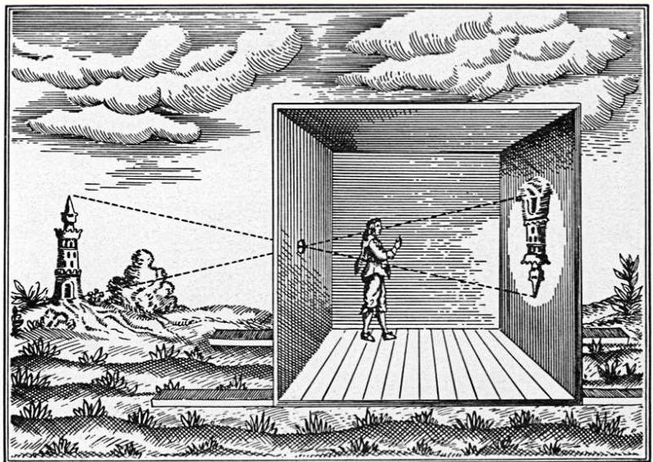
The Pinhole Camera model
Source: Wikimedia

Slide 14
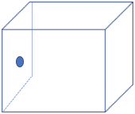
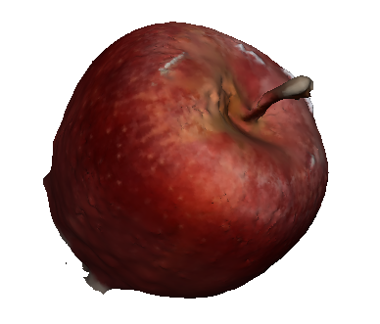
The Pinhole Camera model
Camera Projection
The pinhole camera model
Image plane cuts the rays

Slide 15
The Image plane
Camera Projection
Mathematically equivalent
Simpler to model if it is assumed on the front at distance 1.
Image plane cuts the rays
O
Replace with a 3D object
Any difference?

Slide 16
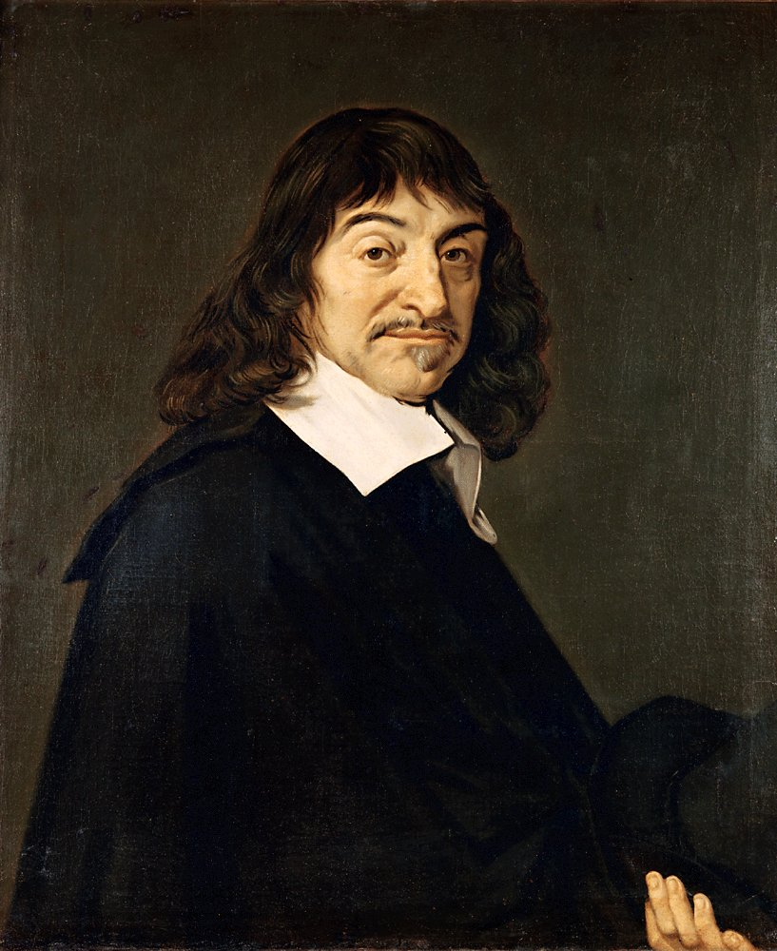
Coordinate Frames
Define projection in a camera
Y
X
Z
Right hand coordinate system

Slide 17
Camera axis
Assume orientations
Z – axis passes perpendicular to the image plane
x
O
z
y
Focal length = 1

Slide 18
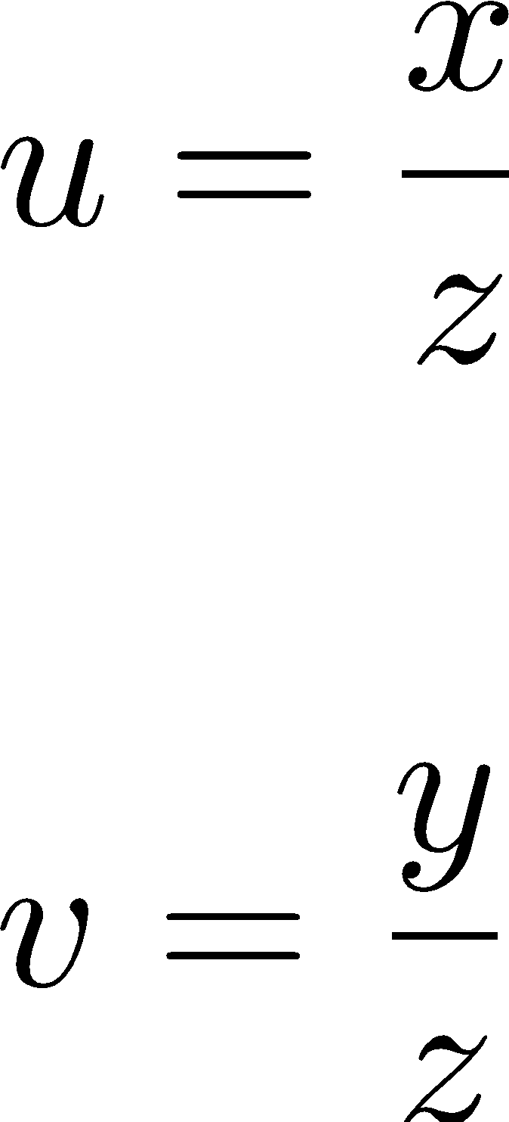
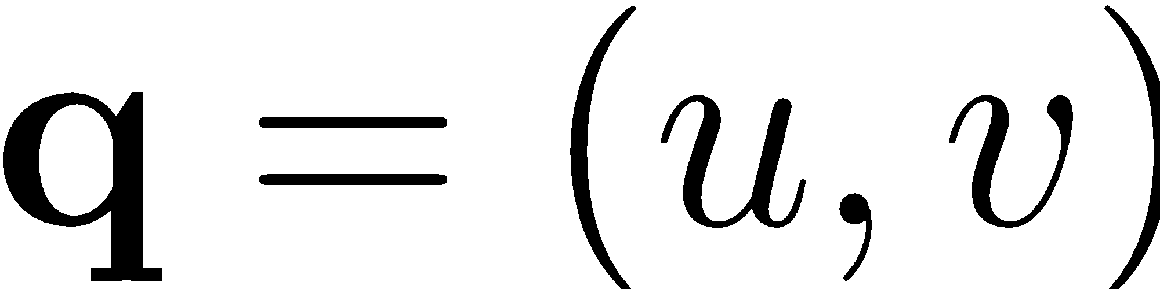
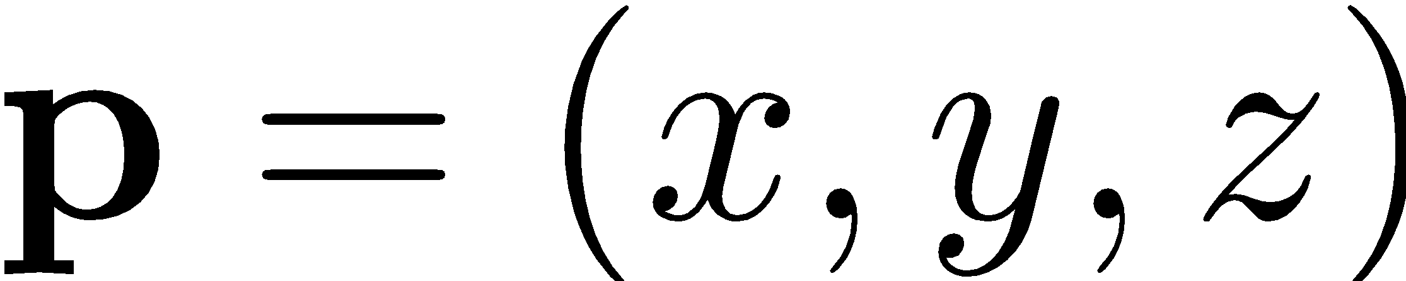
Image coordinates
Projection equations
Image plane coordinate system
Can you prove them? – Exercise!
O
z
u
v
What kind of equations are they?

Slide 19
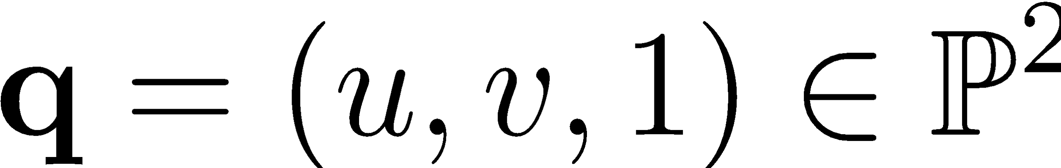
Image coordinates
Linear form
Homogeneous coordinates
Although 3 elements are used they represent projected points in 2D!
O
u
v
Homogeneous coordinates!

Slide 20
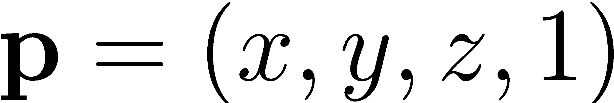

Image coordinates
Linear form
Homogeneous coordinates
Same for the 3D points!
O
u
v
Homogeneous coordinates!

Slide 21
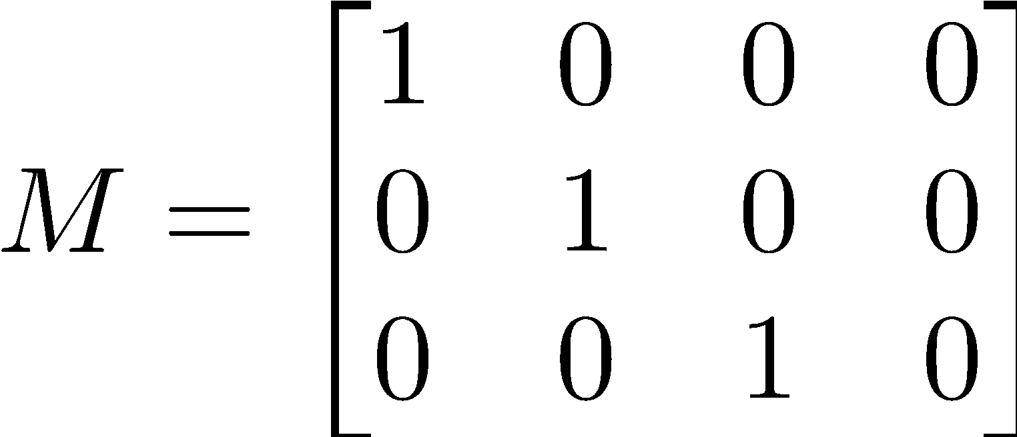

Projection matrix
Linear form
Homogeneous coordinates
Same for the 3D points!
O
Verify:
u
v

Slide 22

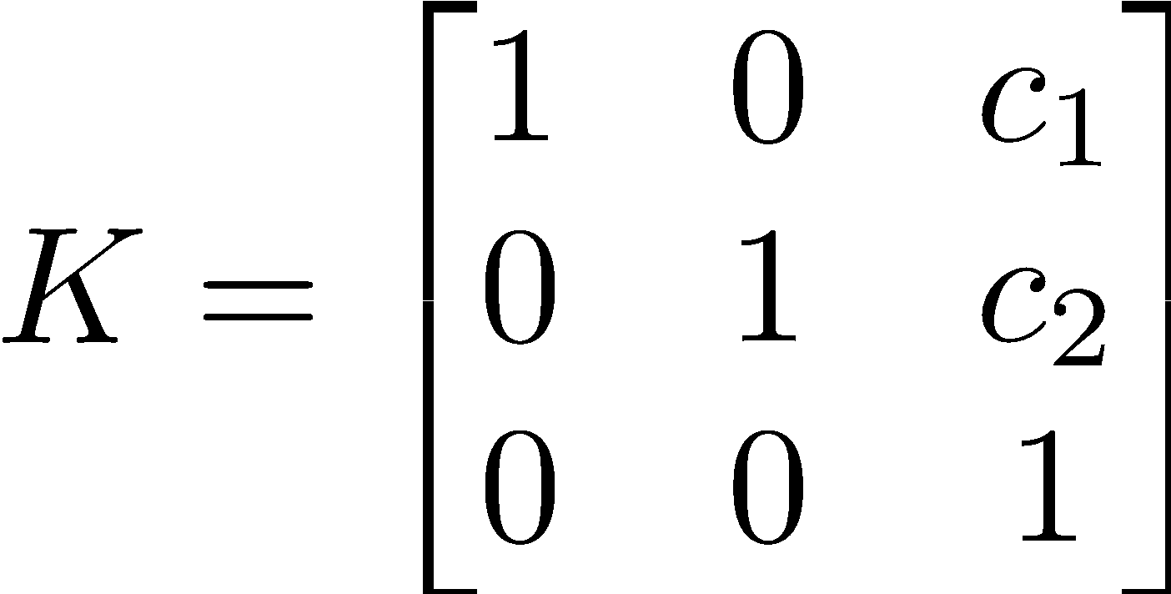
Your cameras are not pinhole!
Image origin is at the top left
This changes the projection equation!
Introduce the camera calibration matrix
u
v
O

Slide 23

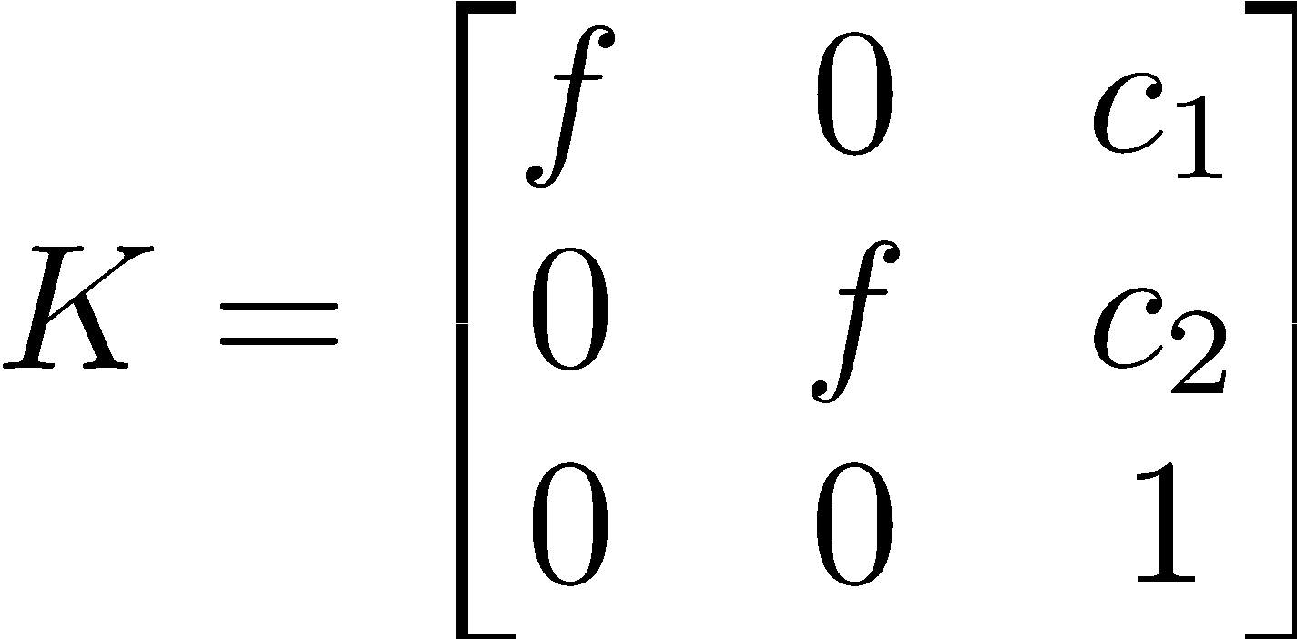
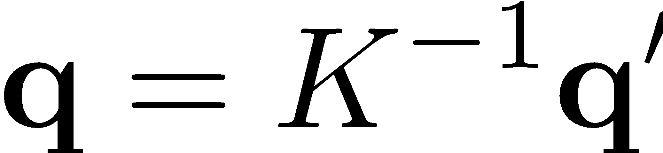
Your cameras are not pinhole!
The focal length is much greater than 1 pixel.
Scale the image coordinates.
u
v
O

Slide 24





Two-view geometry
Two pinhole cameras
Epipolar geometry
Camera 2
Camera 1

Slide 25
Two-view geometry
Two pinhole cameras
Epipolar geometry
Epipolar Plane
Camera 2
Camera 1

Slide 26


Two-view geometry
Two pinhole cameras
Corresponding points
Epipolar Plane
Camera 1
Camera 2

Slide 27
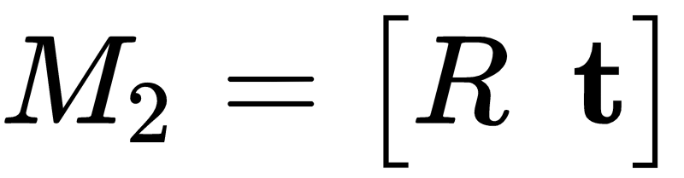

Two-view geometry
Camera 2 has been rotated and translated.
Corresponding points
Camera 1
Camera 2

Slide 28
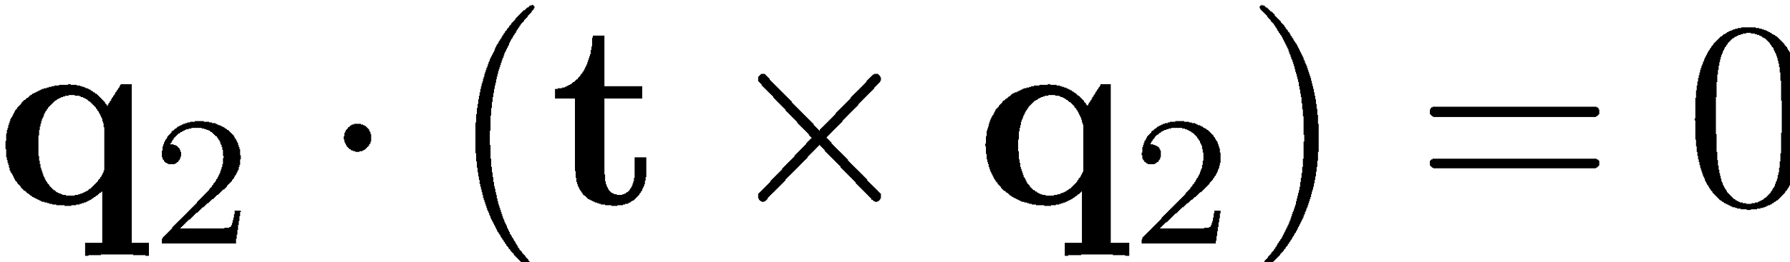

Two-view geometry
Camera 1
Camera 2

Slide 29
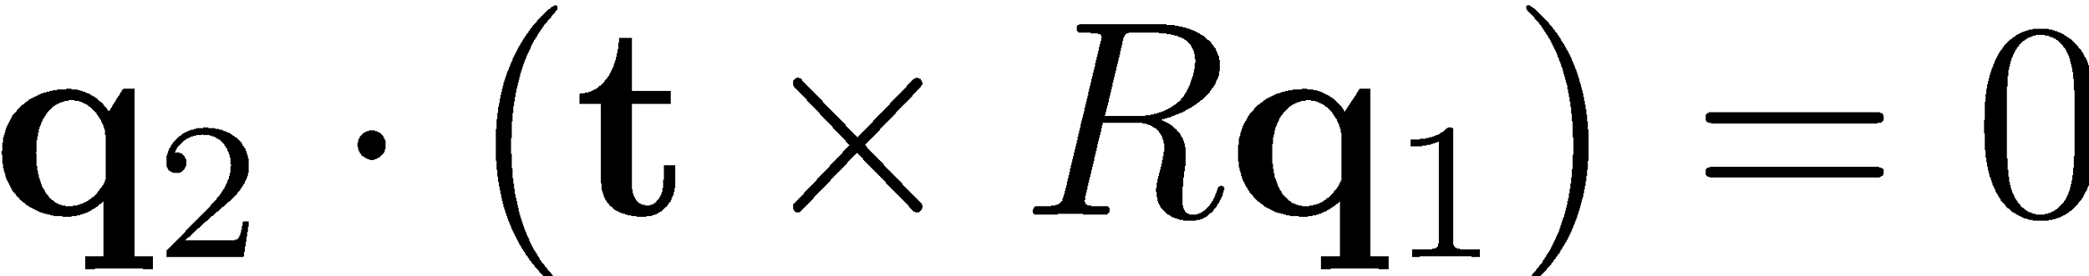
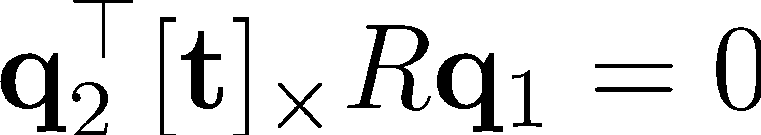
Two-view geometry
Camera 1
Camera 2

Slide 30

The Essential Matrix
Essential matrix is:
Rank 2 matrix
2 equal non-zero singular values
What about the last singular value?

Slide 31
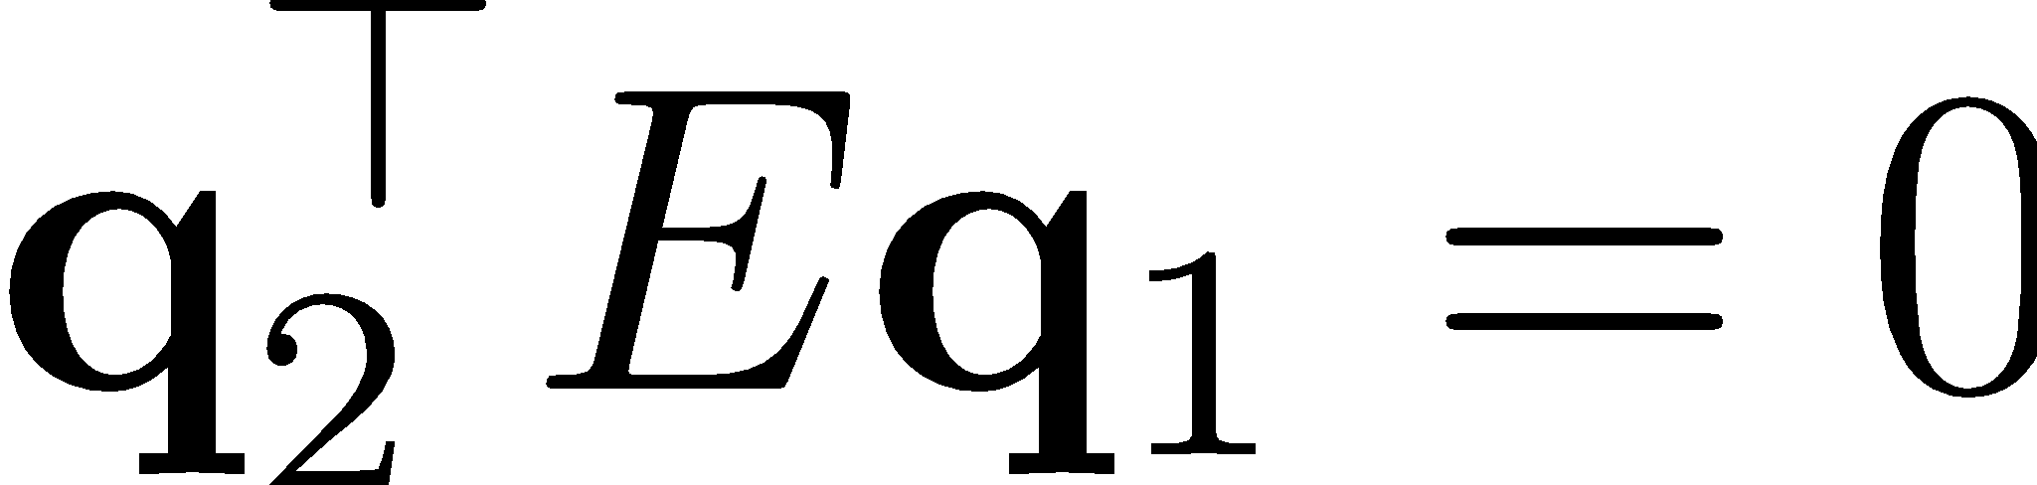
The Essential Matrix
True for all corresponding points:
Mathematically,

Slide 32
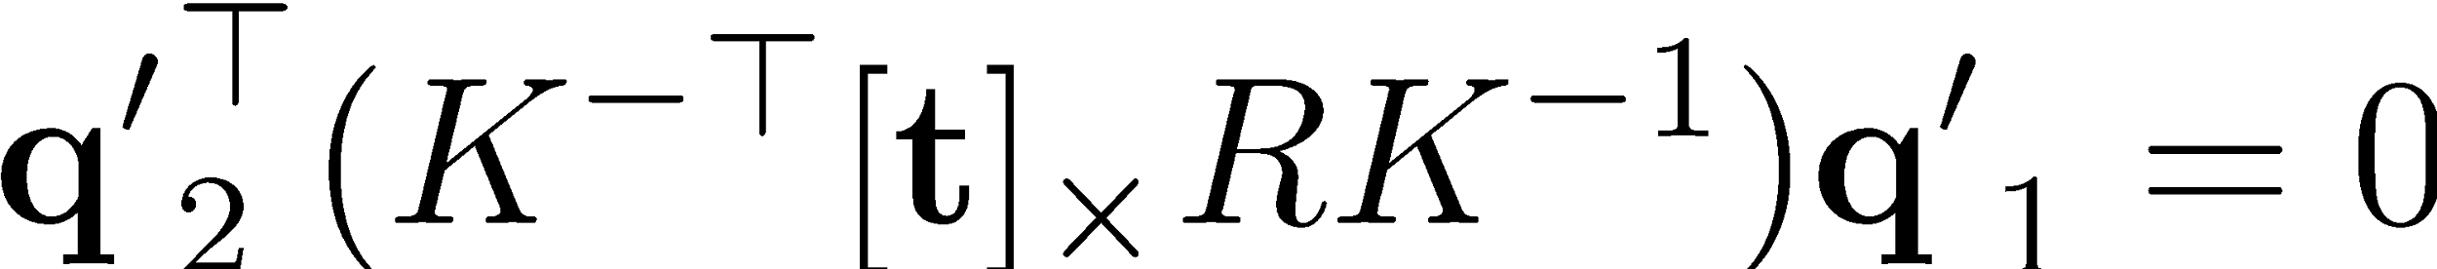
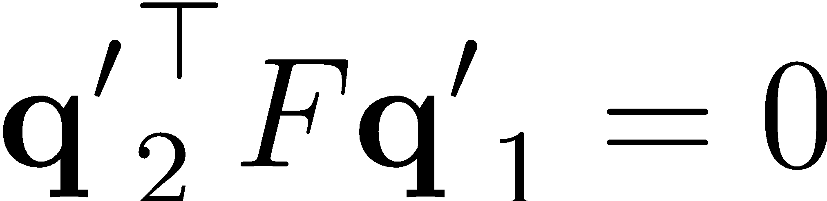
The Fundamental matrix
For cameras with different focal length and principal point
Too many equations!!

Slide 33
The Fundamental matrix
For all corresponding points:
Properties:
Lets discuss!! What does it mean by the rank being 2?

Slide 34




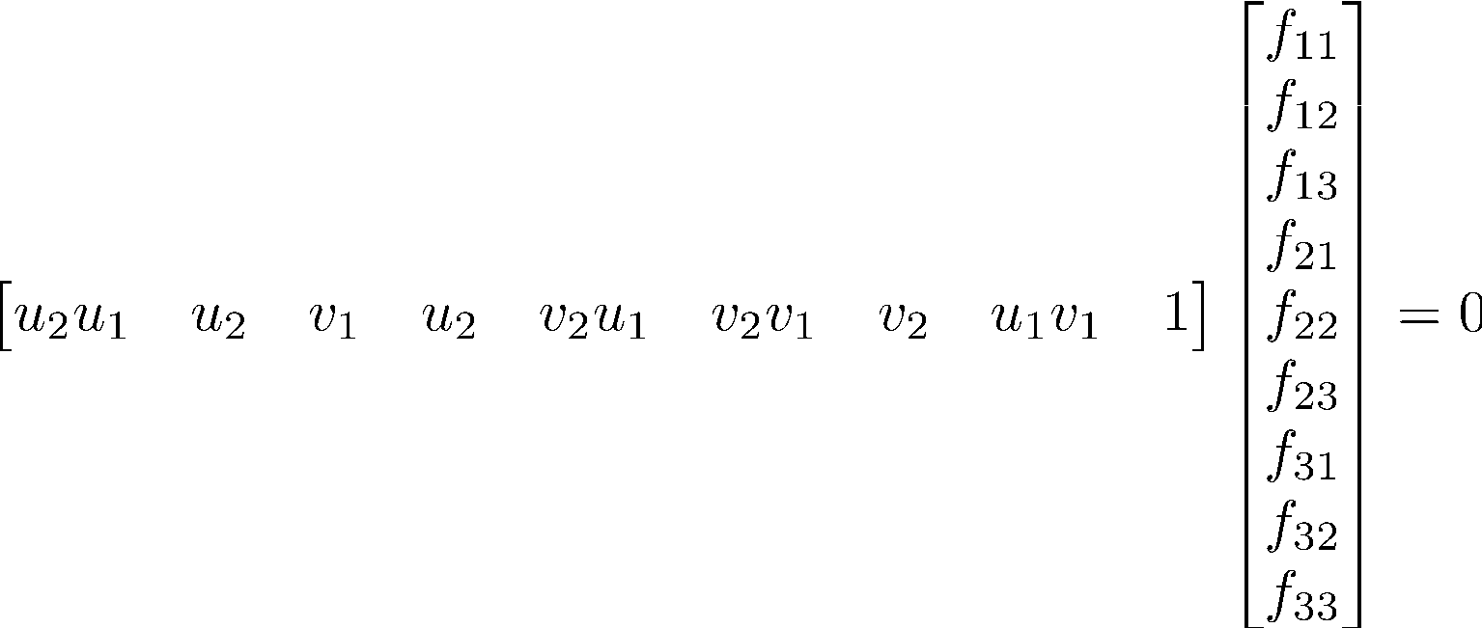



The 8-point Method
Given many correspondences, compute
Requires at least 8 points to solve!

Slide 35
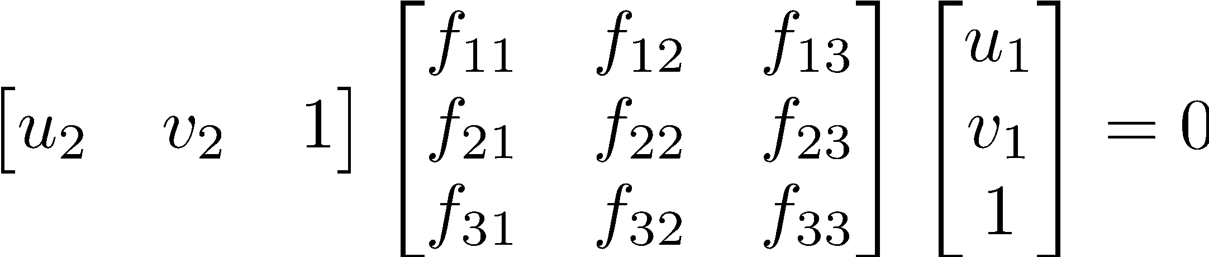
The 8-point Method
Given many correspondences, compute

Slide 36
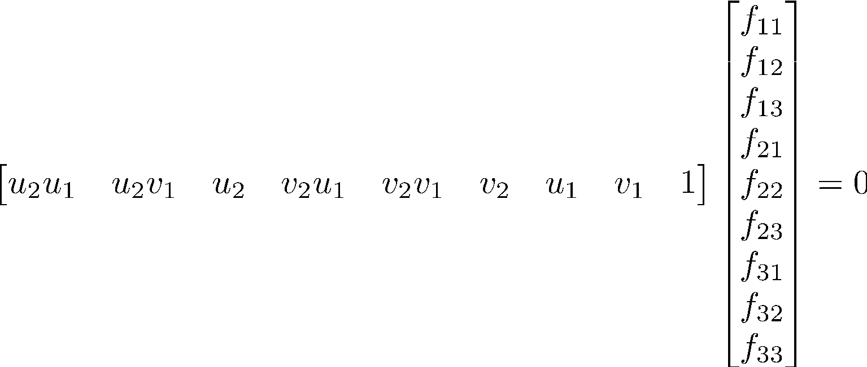
The 8-point Method
Given many correspondences, compute

Slide 37

The 5-point Method
Can you do better for the Essential matrix?
Matrix constraint

Slide 38

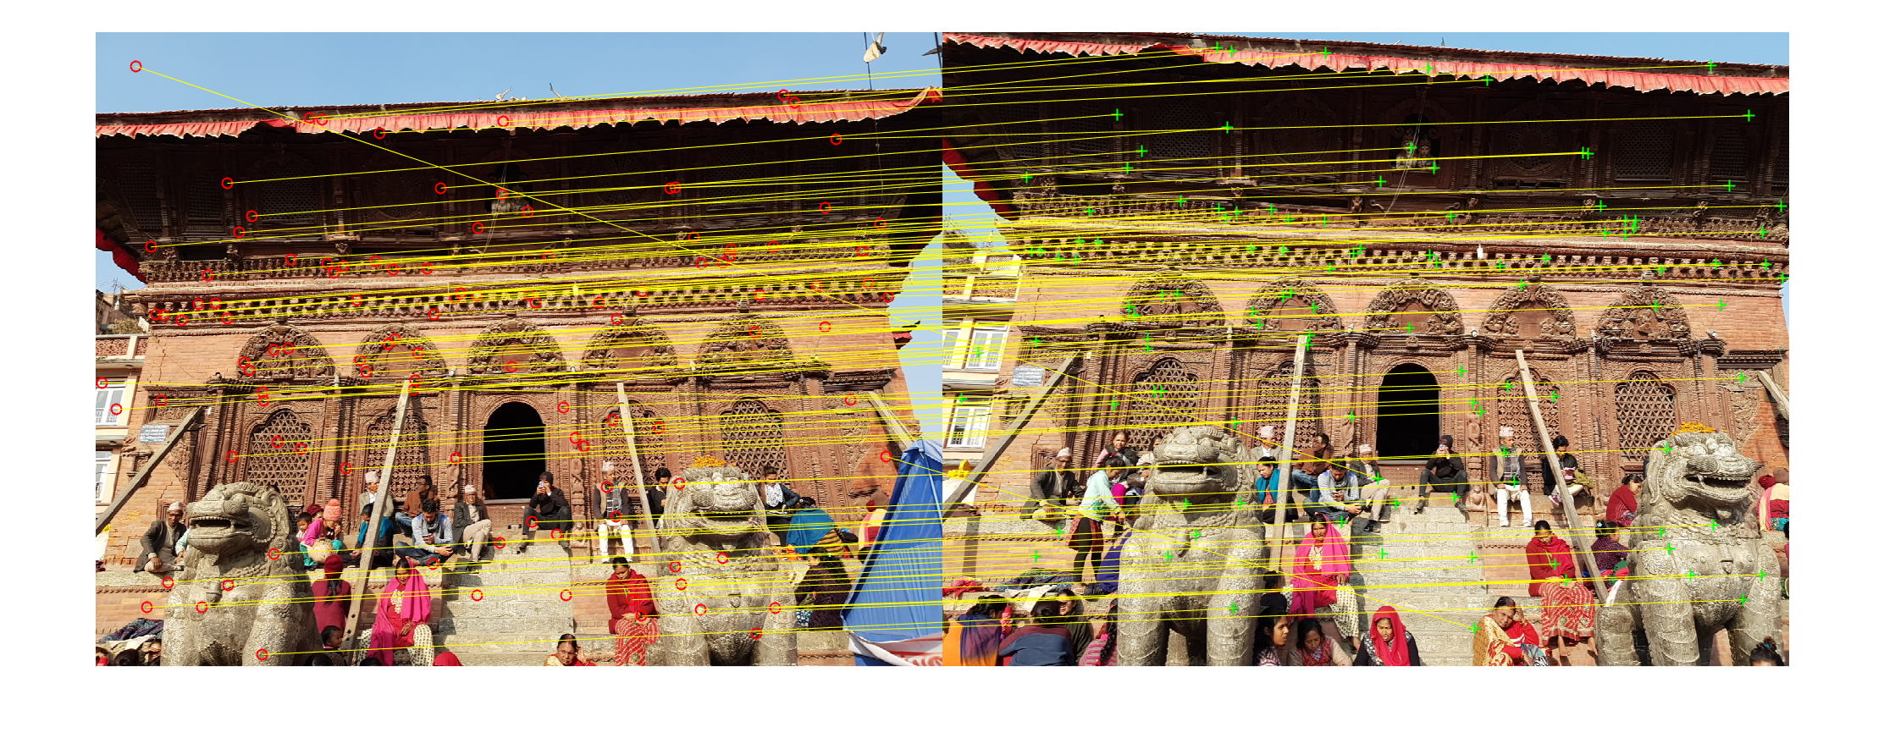
Corresponding points
Find matching “keypoints” in images:
Scale Invariant Feature Transform (SIFT) – [Lowe, 2004]
Returns “most unique” points in images

Slide 39

Triangulation
Obtain 3D from 2D images

Slide 40

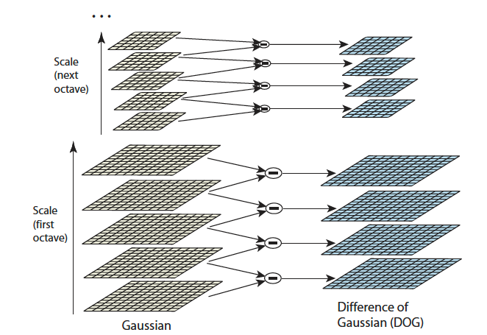


SIFT
Scale Invariant Feature Transform [Lowe 2004]

Slide 41
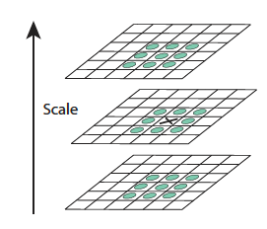
SIFT
Scale Invariant Feature Transform

Slide 42
Structure-from-Motion
Multi-view triangulation
Triangulate with two views
Transfer points to common reference
Minimize triangulation error – Bundle adjustment
Sparse 3D points
Compute dense 3D points

Slide 43


Structure-from-Motion
Compute relative pose

Slide 44
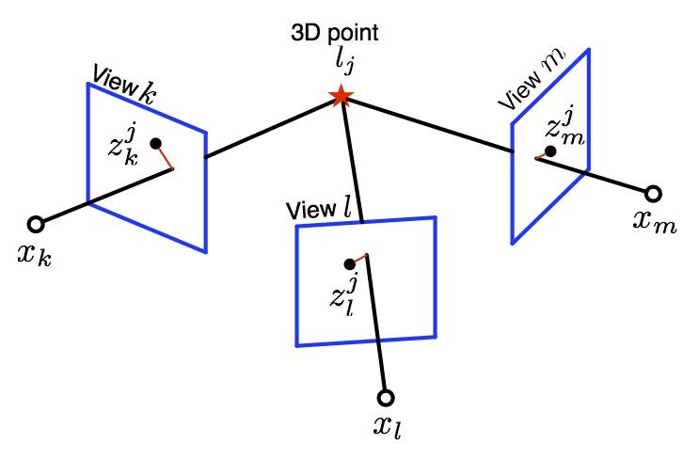
Structure-from-Motion
Multi-view triangulation
Source: Vadim Indelman, ANPL

Slide 45
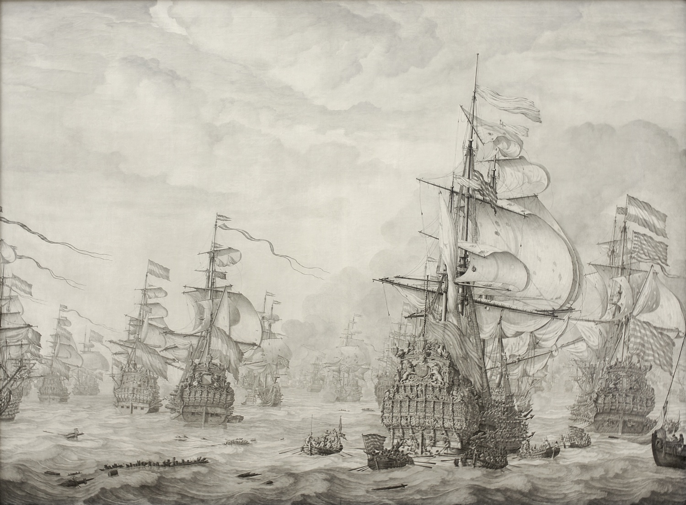
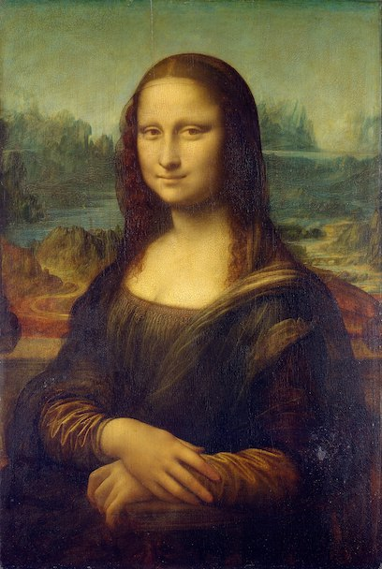
3D Visual Cues
Find 4 different depth/shape cues
Willem van de Velde the Elder's The Capture of the Royal Prince during the Four Days' Battle (1666)

Slide 46
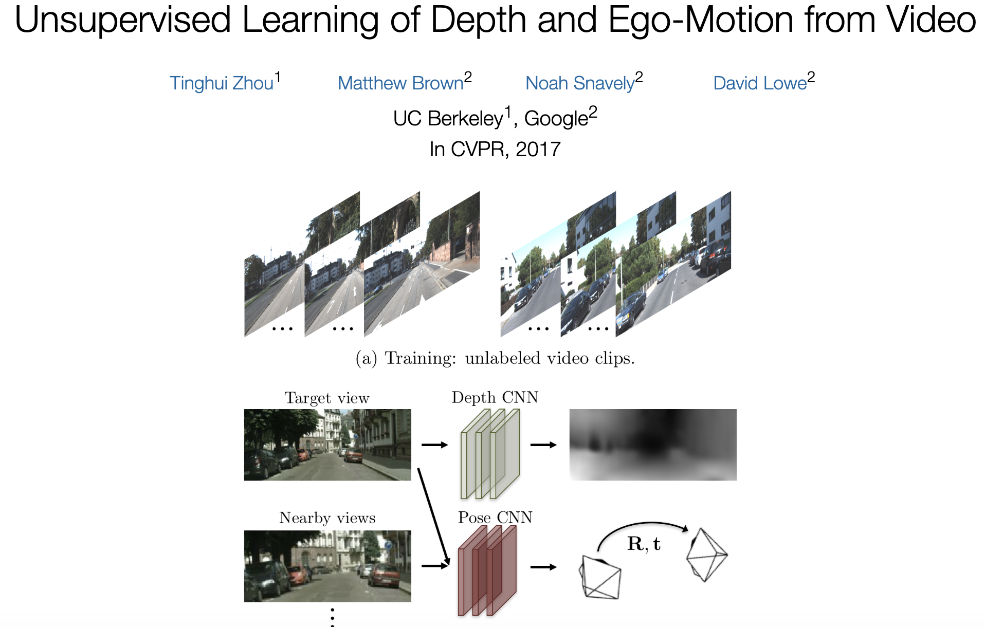
Application - Unsupervised Learning

Slide 47
More problems
2D Image Homography
3D - 3D Registration problem

Slide 48
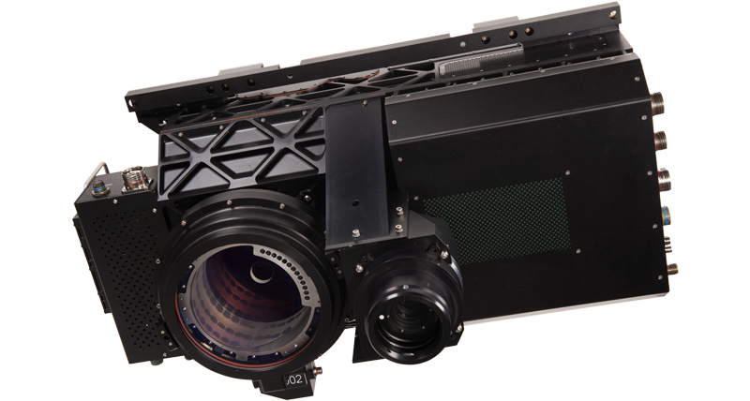
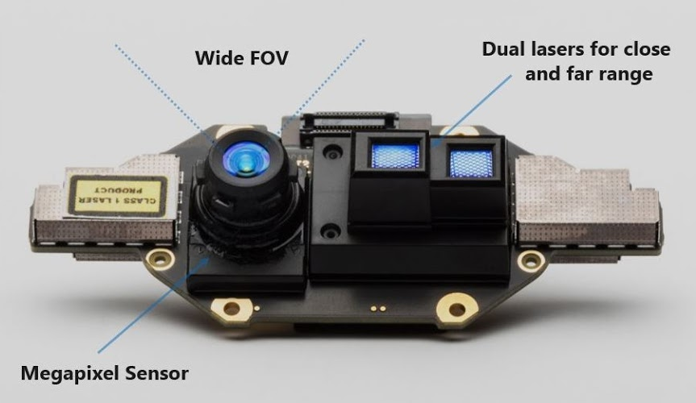

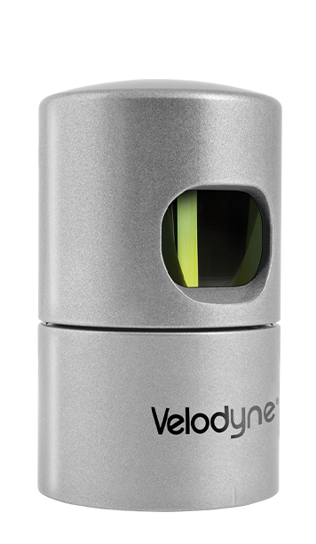
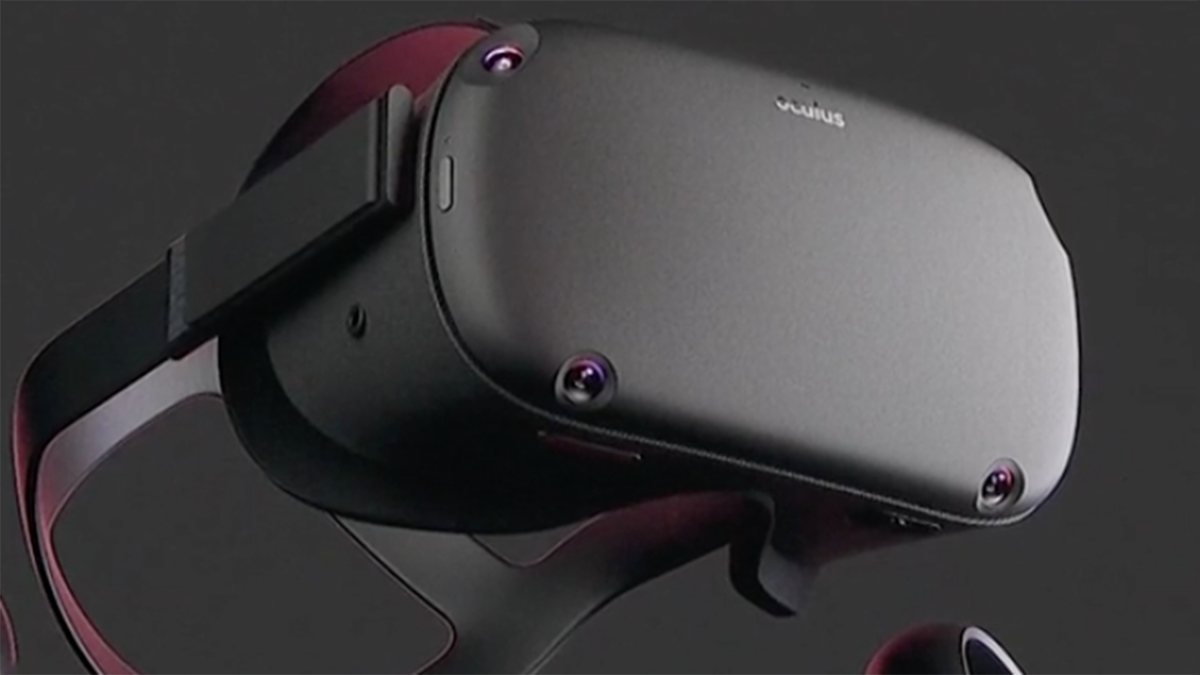
Devices for Depth
Depth sensors

Slide 49
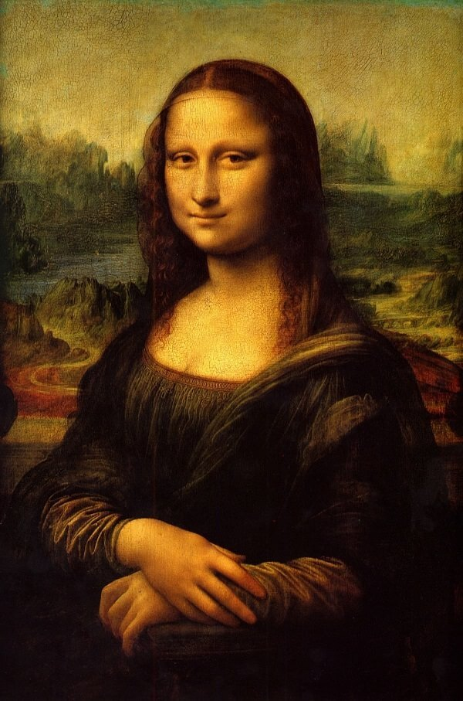

Application - Bokeh effect
Selective blur
Mobile phones:
Artificially done by depth
prediction

Slide 50
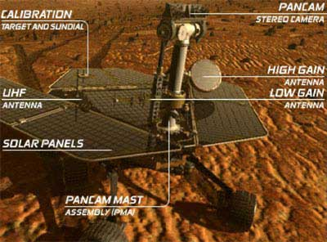
Application - Mapping and Robotics
Problem:
Find motion and depth
Do it online and fast!
SLAM
Source: NASA/JPL

Slide 51
Application: VR
Problem:

Slide 52
Application - Panoramic Image

Slide 53
Application - Learning Segmentation

Slide 54
Existing software
Examples
COLMAP
PIX4D
PhotoScan
OpenSfM

